Slide 1
Predicting the Success of a Movie before its release
Sahiti Katragadda
Pravallika Vanukuri

Slide 2
Idea
To predict the success of a movie using data analysis techniques and data gathered from various social platforms(IMDB, YouTube and Twitter) to provide constructive feedback in pre-production phase.

Slide 3
Motivation
Previous work – Within the first week of movie release
Built two prediction models separately,
- Using conventional features such as Cast of a movie, genre, budget and production house.
- Using Social media features such as sentiment score from tweets.

Slide 4
Project Overview:
Building a prediction model by integrating both conventional and social media features and predicting success of a movie before its release.
Predict the success of a movie.
If the rating > 7 – success
rating = 5 to 7 – average
rating < 5 – unsuccessful.
Evaluate the prediction model

Slide 5
Data Collection:
Movie’s list (2016)
142 English Movies
Twitter
You Tube
IMDB
Twitter API
YouTube API
OMDB API
Director, Actors, Production, Title, runtime, previous success history, competition factor, release date
Aggregated number of followers
No of likes, dislikes, views, and sentiment score for trailer

Slide 6
Data Collection Methods
Searched movie titles based on the year (2016).
Used OMDB API to collect data from IMDB -- http://www.omdbapi.com/?
Based on the data extracted from OMDB, mapped the cast details with the screen names in twitter(searchUsers method) to find aggregate number of followers (actors, directors and production house)
YouTube API -- https://www.googleapis.com/youtube/v3/
  Search method – retrieved video ID’s based on movie titles.
  commentThreads method – Based on the video ID, extracted comments.
  Videos method – extracted likes, dislikes, views.

Slide 7
Data Preprocessing
Followers
Minimum number of followers for better identification
Description in their twitter profiles – actor or actress
Few actors do not have twitter accounts – fan pages with highest followers is considered.
Previous success history of actors and director ( -1 , 0, 1 )
Competition factor – Based on total number of movies released before and after 2 weeks of a particular movie release date.

Slide 8
Tools
JAVA – data collection and preprocessing
R – To calculate sentiment score for YouTube Comments.
Tableau – Initial Analysis
Weka – Decision Tree

Slide 9
Few Initial Insights

Slide 11
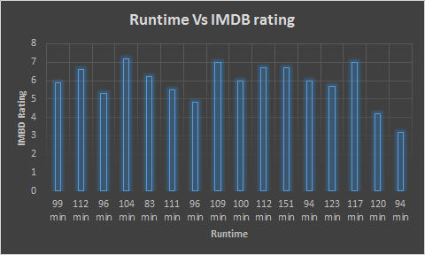

Slide 12
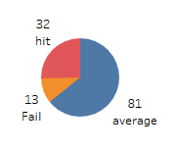

Slide 13
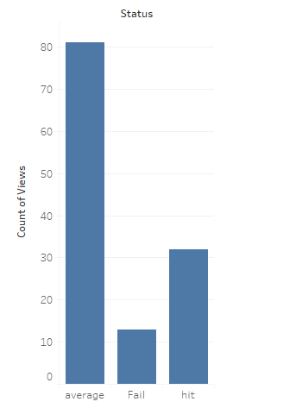

Slide 14
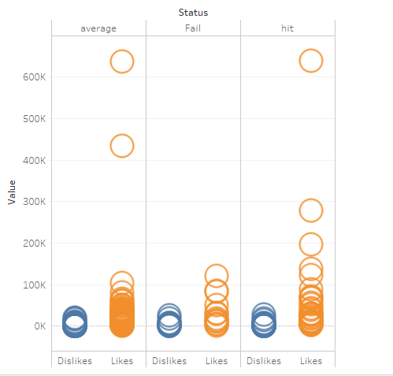

Slide 15
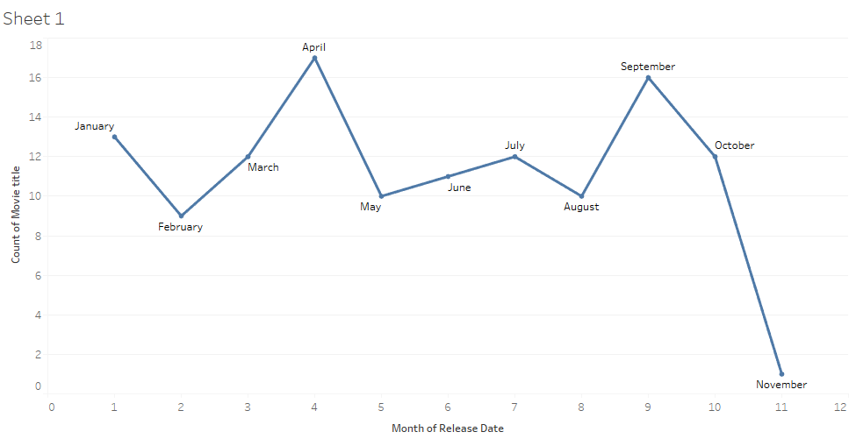

Slide 16
Decision Tree:
142 English movie details as ground truth data.
Divided 75% of the data into Training set and 25% as Test set.
Got an accuracy of 78.3%

Slide 17
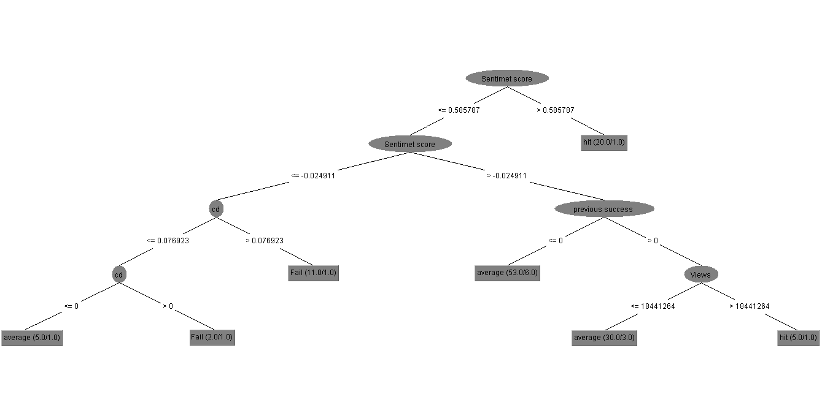

Slide 18
THANK YOU !!!

